Slide 1
Meeting Notes 01_10.

Slide 2
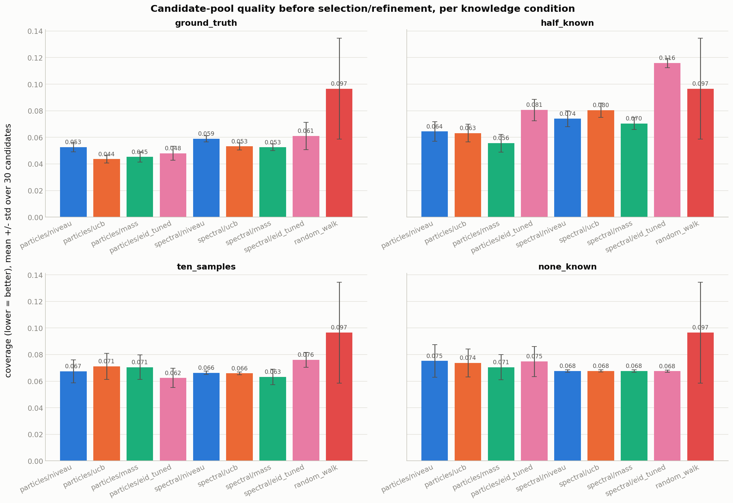
Evaluation results – trajectory distributions

Slide 3
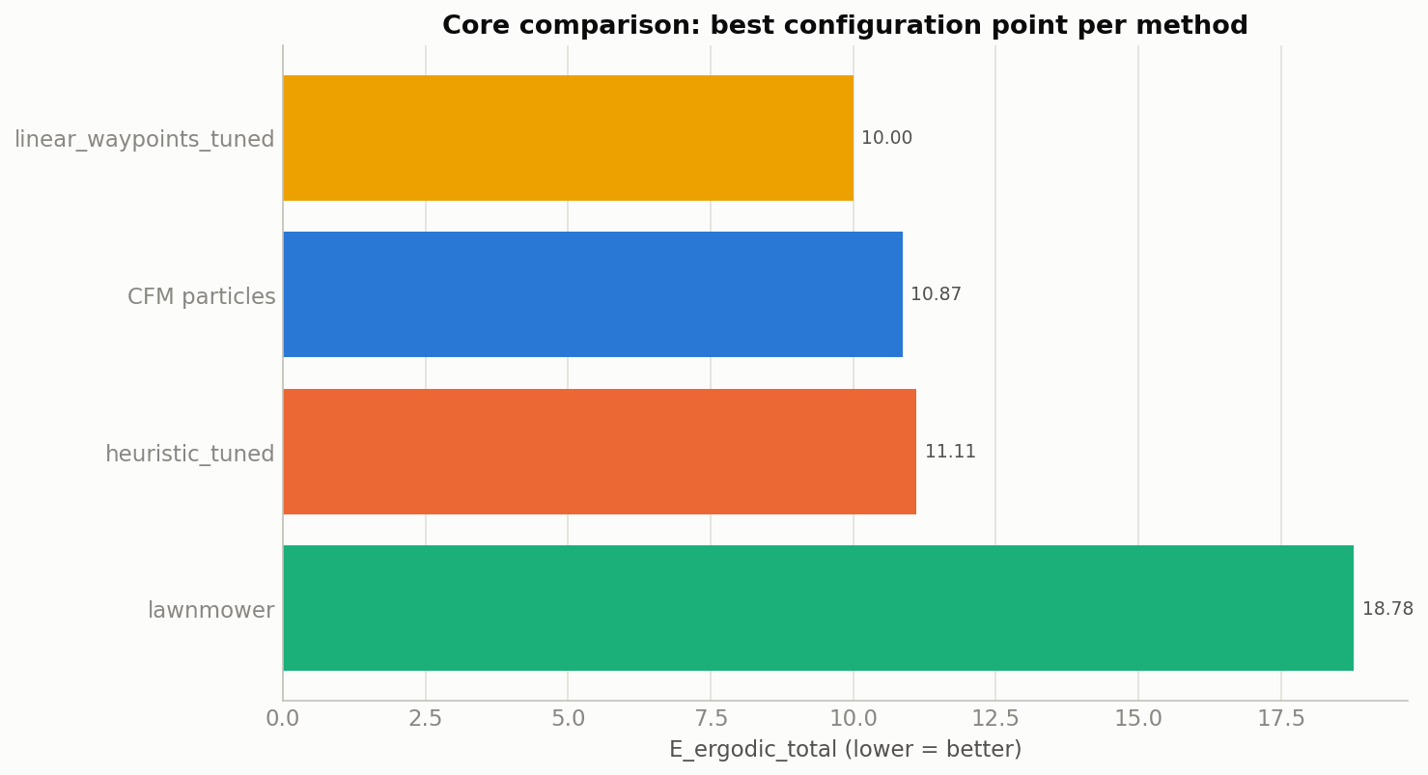

Slide 4
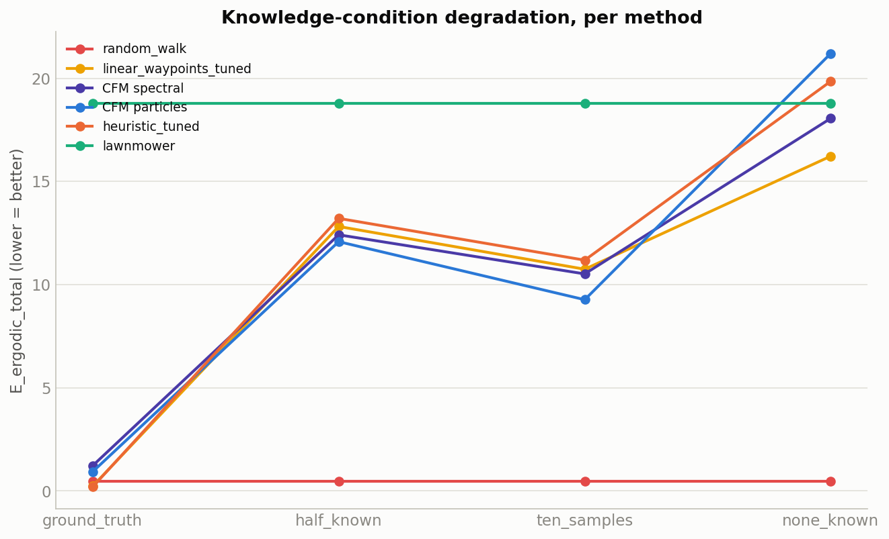

Slide 5
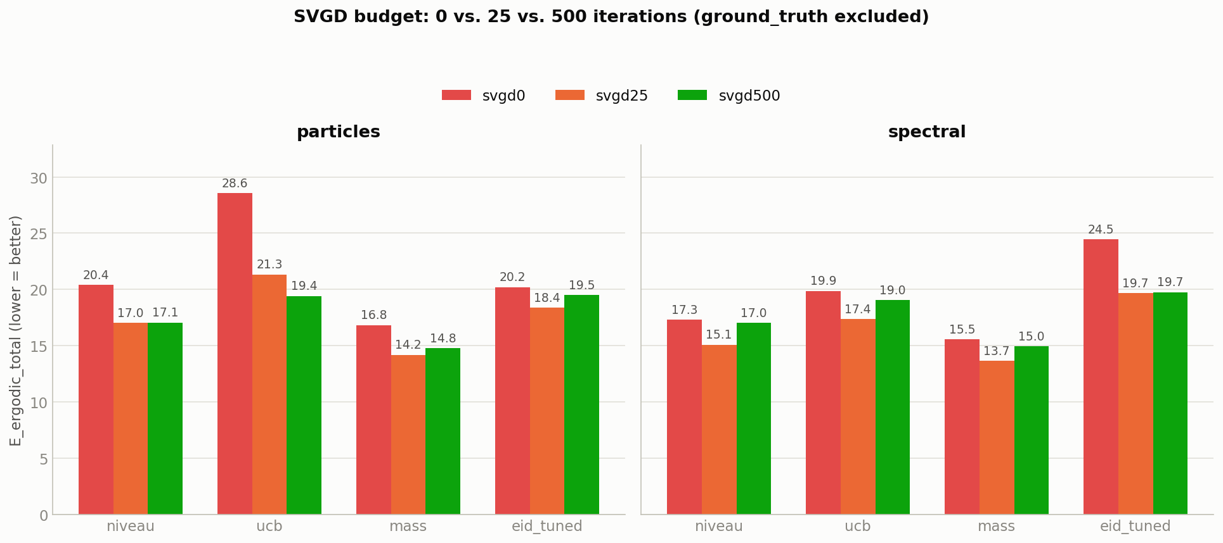

Slide 6
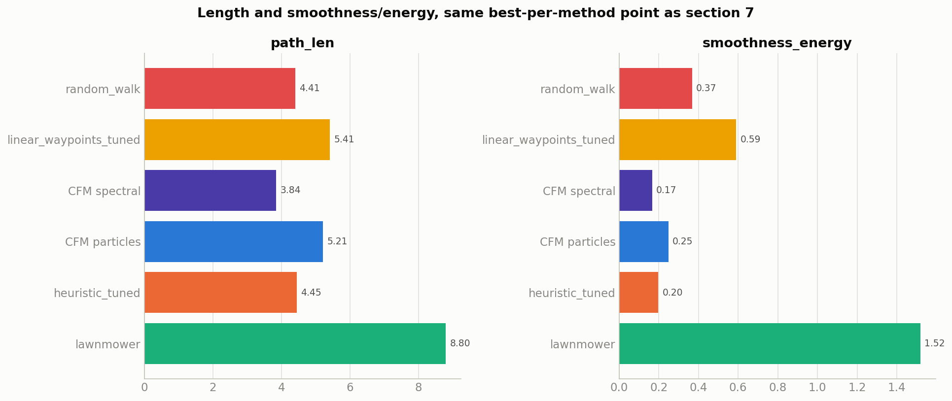
Path length and smoothness

Slide 7
Other talking point
Real Robot tests?
Prepare a testing setup
3D robot arm trajectory constraints (constraints not just on surface) are so far not considered. Considering them would need a planning in joint space

